Slide 1
A
B

Slide 3
High Potential
Low Potential
E
+ + + + + + + + + + + + + + + + + + + + + + + + + +
+ + + + + + + + + + + + + + + + + + + + + + + + + +
+
A
B
- - - - - - - - - - - - - - - - - - - - - - - - - - - - - -
- - - - - - - - - - - - - - - - - - - - - - - - - - - - - -
d

Slide 4
Negative Electrode made of porous lead
Positive Electrode made of lead dioxide
Pb
PbO₂
H₂O
H₂SO₄

Slide 5
Negative Electrode made of porous lead
Positive Electrode made of lead dioxide
Pb
PbO₂
H₂O
H₂SO₄
H₂SO₄
H₂O

Slide 6
Negative Electrode made of porous lead
Positive Electrode made of lead dioxide
H⁺
SO₄⁻²
Pb
PbO₂
H₂O
H⁺
H⁺
SO₄⁻²
H⁺
H₂O

Slide 7
Pb⁰
Pb⁰
SO₄⁻²
Pb⁰
H⁺
H⁺
Pb⁰
H₂O
Pb⁰
H⁺
SO₄⁻²
Pb⁰
Pb⁰
H₂O
H⁺
Pb⁰
H⁺
Pb⁰
SO₄⁻²
Pb⁰
H⁺
H₂O
Pb⁰
Pb⁰

Slide 8
Pb⁰
Pb⁰
Pb⁰
Pb⁰
Pb⁰
H⁺
SO₄⁻²
Pb⁰
Pb⁰
H₂O
-
H⁺
Pb⁰
H⁺
-
Pb⁺²
SO₄⁻²
Pb⁰
H⁺
H₂O
Pb⁰
Pb⁰

Slide 9
O⁻²
Pb⁺⁴
O⁻²
H⁺
O⁻²
SO₄⁻²
Pb⁺⁴
H₂O
H⁺
O⁻²
O⁻²
-
H⁺
SO₄⁻²
Pb⁺⁴
O⁻²
-
H⁺
H₂O
O⁻²
Pb⁺⁴
O⁻²

Slide 10
O⁻²
Pb⁺⁴
O⁻²
O⁻²
SO₄⁻²
Pb⁺⁴
O⁻²
H₂O
₋₂
SO₄⁻²
Pb⁺²
H₂O
H₂O
O⁻²
Pb⁺⁴
O⁻²

Slide 11
Pb⁰
O⁻²
Pb⁰
Pb⁺⁴
Pb⁰
O⁻²
Pb⁰
O⁻²
SO₄⁻²
Pb⁰
Pb⁺⁴
H⁺
SO₄⁻²
Pb⁰
O⁻²
H₂O
Pb⁰
H₂O
-
H⁺
₋₂
Pb⁰
SO₄⁻²
Pb⁺²
H⁺
-
Pb⁺²
SO₄⁻²
H₂O
Pb⁰
H₂O
O⁻²
H⁺
H₂O
Pb⁰
Pb⁺⁴
Pb⁰
O⁻²

Slide 12
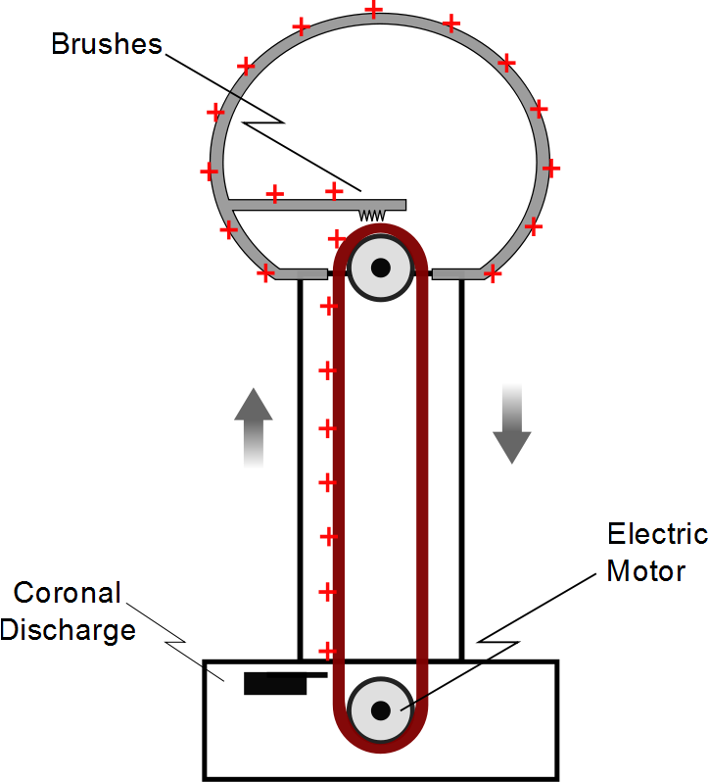

Slide 13
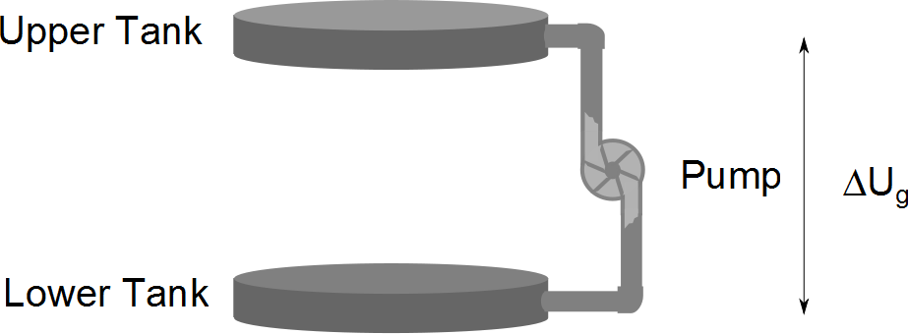

Slide 14
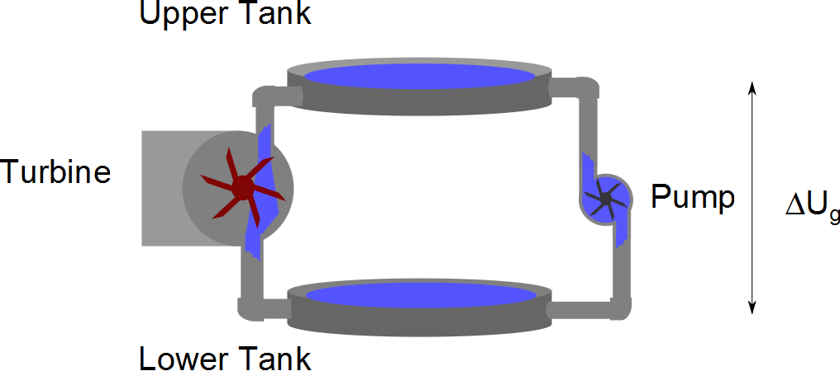

Slide 15
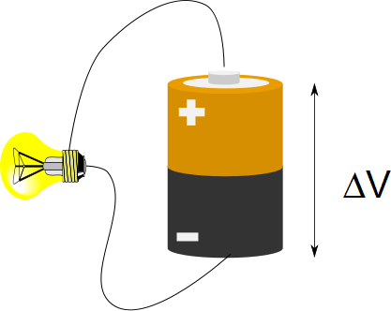

Slide 16
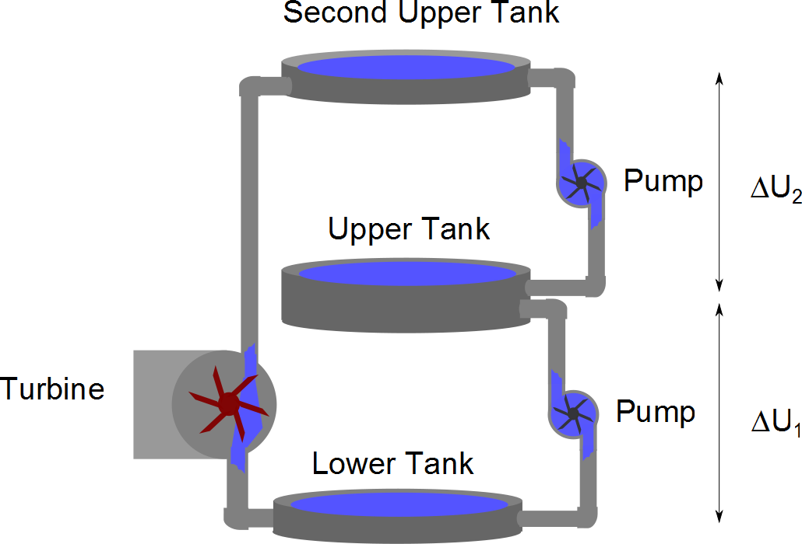

Slide 17
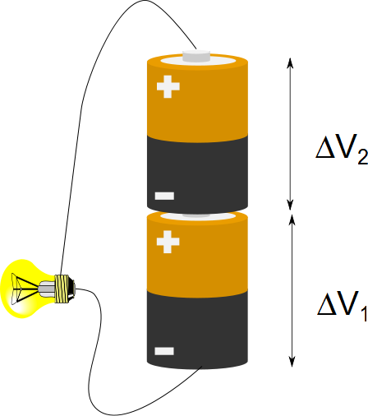

Slide 18
High Potential
Low Potential
E
+ + + + + + + + + + + + + + + + + + + + + + + + + +
+ + + + + + + + + + + + + + + + + + + + + + + + + +
+
A
B
- - - - - - - - - - - - - - - - - - - - - - - - - - - - - -
- - - - - - - - - - - - - - - - - - - - - - - - - - - - - -
d

Slide 19
High Potential
Low Potential
E
- - - - - - - - - - - - - - - - - - - - - - - - - - - - - -
- - - - - - - - - - - - - - - - - - - - - - - - - - - - - -
+ + + + + + + + + + + + + + + + + + + + + + + + + +
+ + + + + + + + + + + + + + + + + + + + + + + + + +
Equipotential Lines

Slide 20
